Slide 1
AISS CV – Group 6 – Food Label Recognition
Gianluca Geraci – Stefan Horst – Felix Kloster – Yiğit Oğuz – Tianran Wei

Slide 2
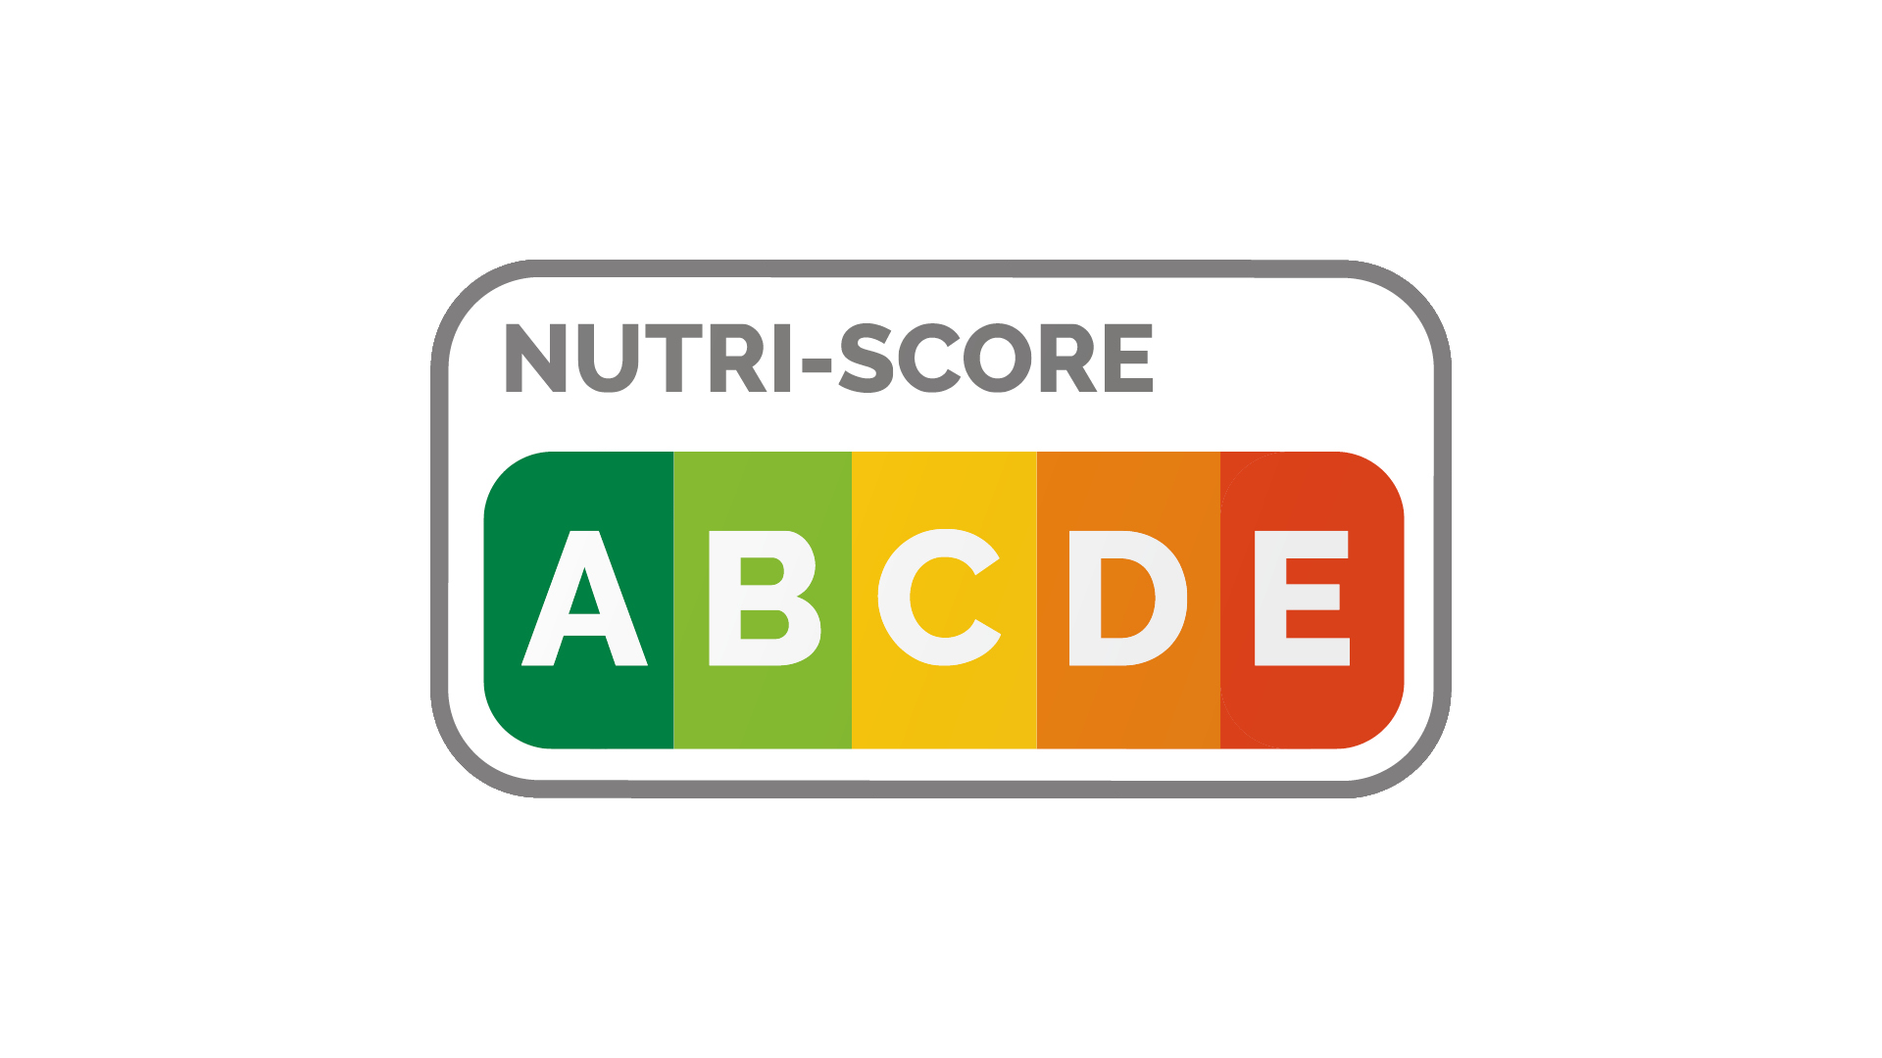




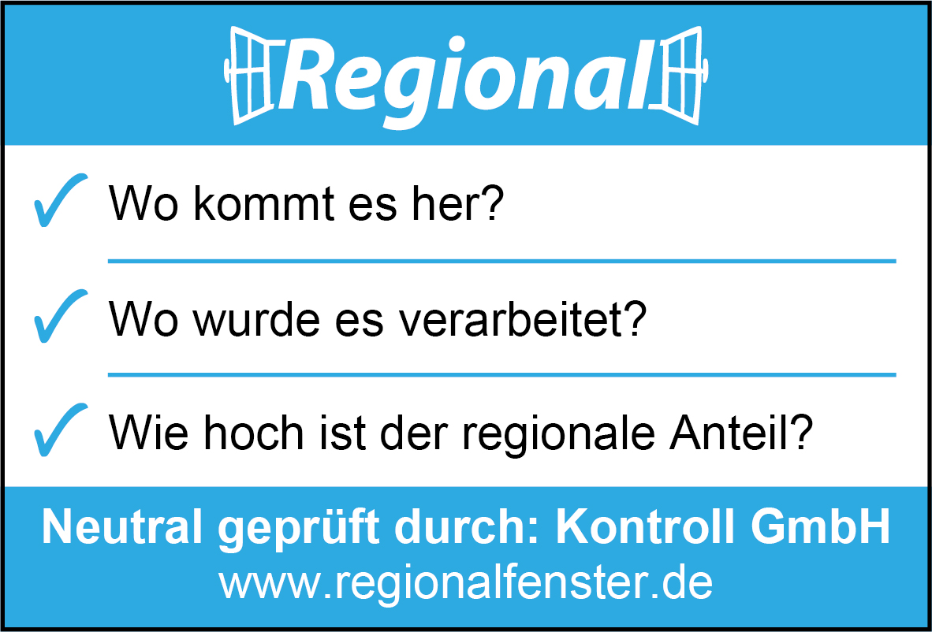









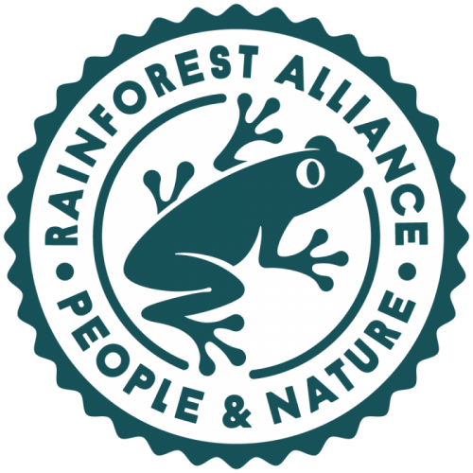

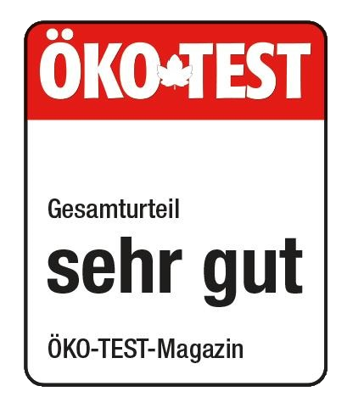













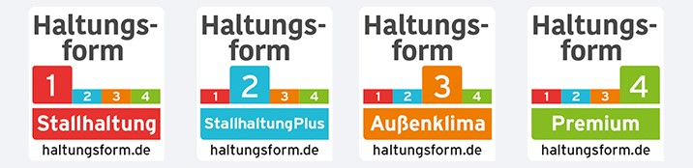

Slide 3
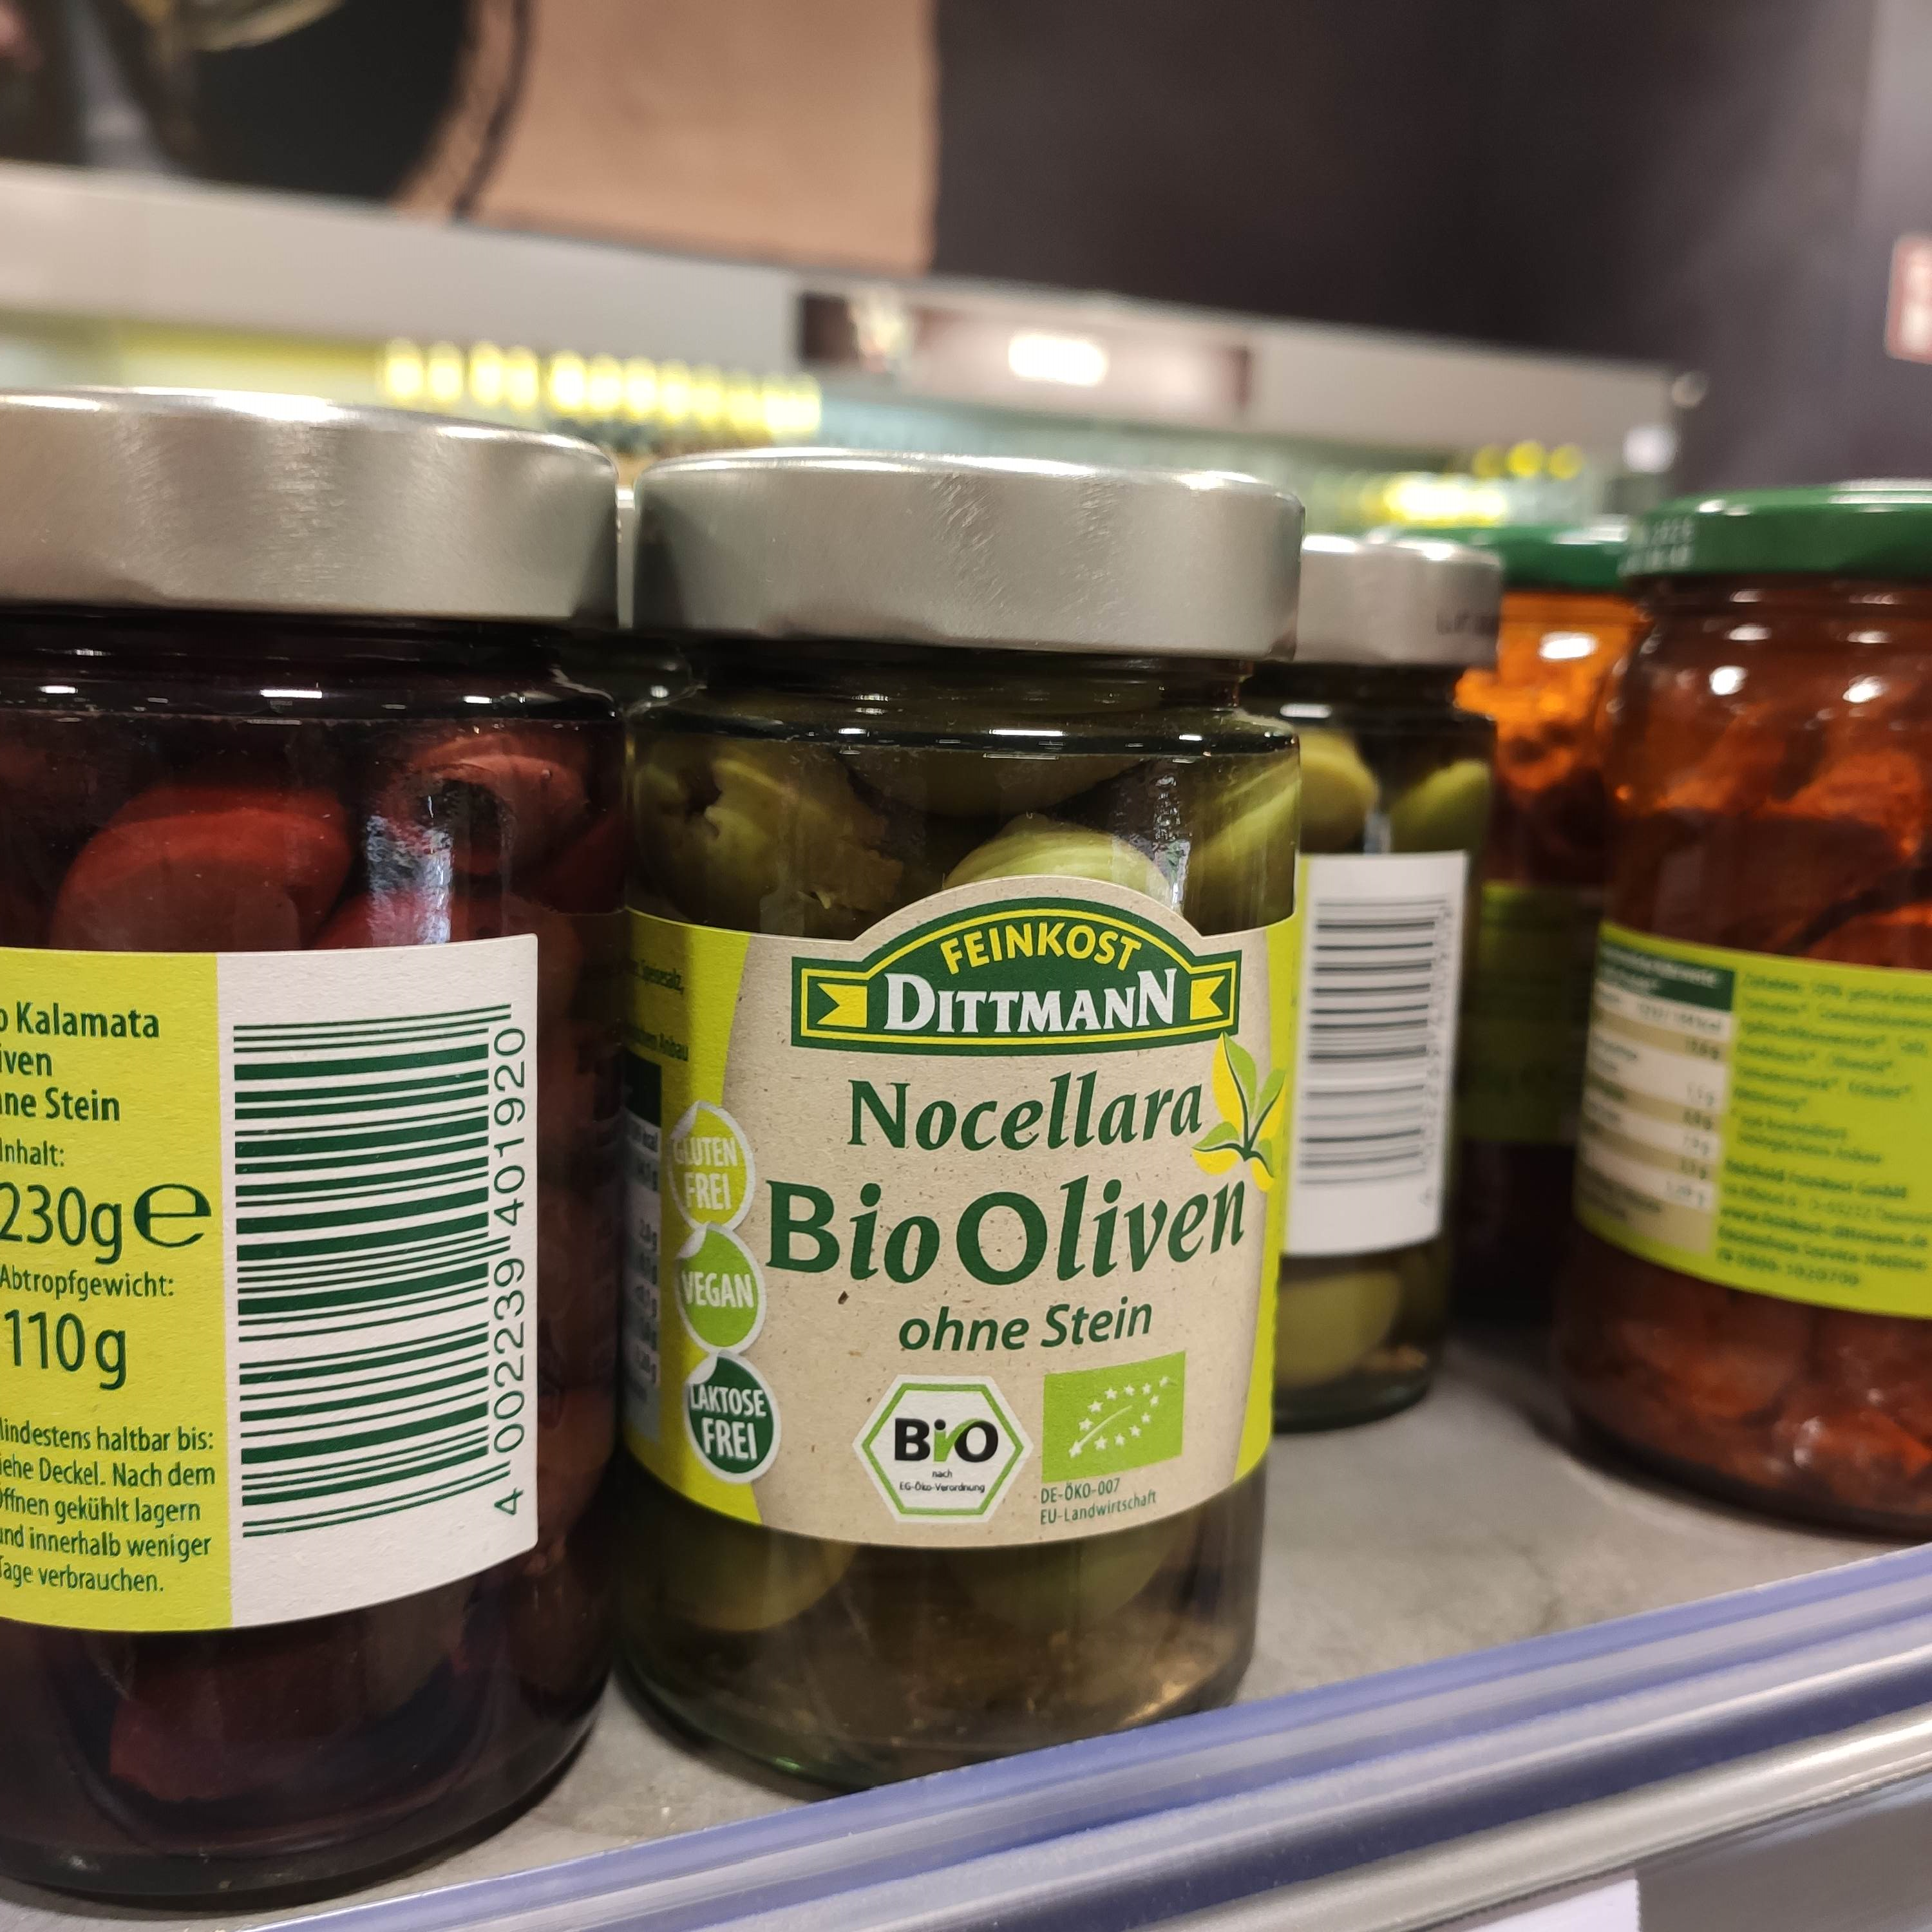
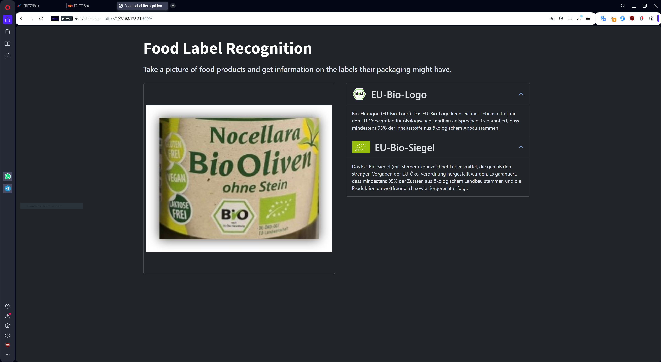


Our Solution
Our CV application detects labels on supermarket items to:
Help users differentiate between legitimate & marketing labels
Provide additional information on legitimate labels
Quickly assess properties and quality of different products while directly engaging with them in the supermarket

Slide 4
Developing Our Solution
Collecting & Preparing Data
Choosing & Training The Model
Evaluating our Model
Putting It All Together

Slide 5





Creating Our Data Set
No suitable data sets publicly available for our use case
Collect Photos
Label Photos
~400 photos
With label: 160
No label: 160
Tool: LabelImg
With label: 37
No label: 37
Notes:
Data Collection
Best Practice:
Tiny-Yolo Model: same amount of images with & without labels

Slide 6


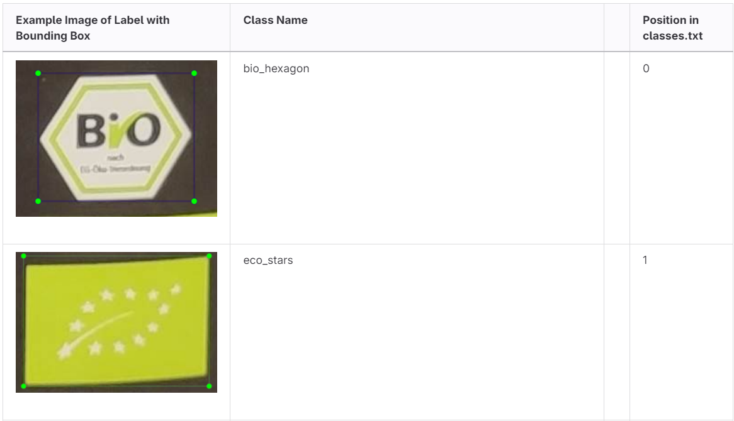
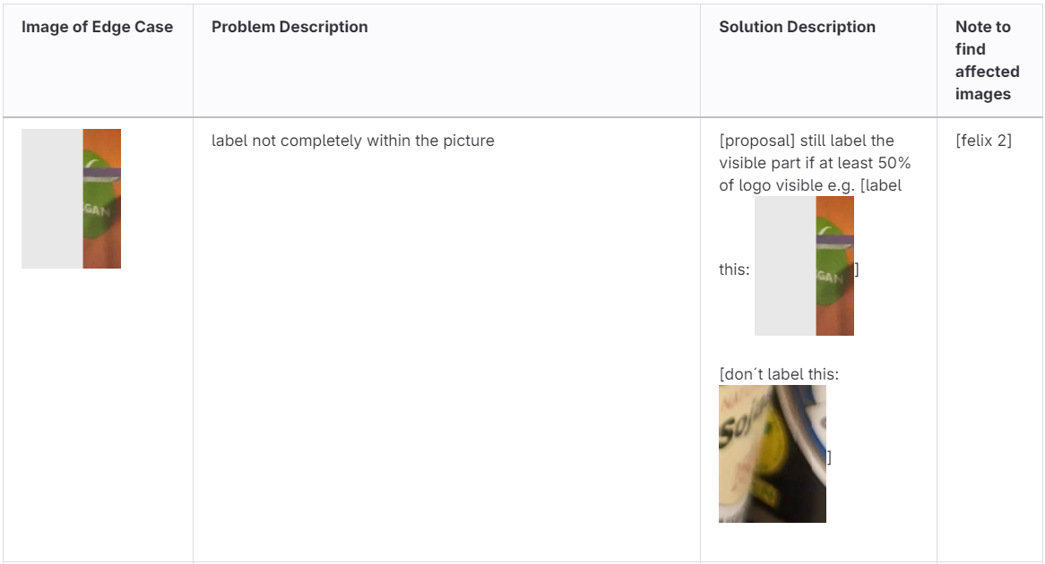
Using Labeling Guidelines To Ensure Consistency
Labeling Wiki
Edge Case Wiki
+ Best Practice Labeling Rules

Slide 7

Data Split and Augmentation
Training and Validation Data: 340 Images
Data Augmentation
85%
~1400 Images
Data Split
Entire Data: 400 Images
Test Data: 60 Images
15%
Notes:
Train test split → then augment train data with our pipeline Data Split and Augmentation
Data Split
Modeling Tuning Phase: 70% Training, 15% Validation, 15% Test
Final Training: 85% Training, 15% Validation
Image Augmentation
Augmentation only on training and validation data in tuning phase to avoid data leakage
Enhance the model's ability to adapt to various lighting conditions, angles, color variations, and lens distortions.
8 augmentation operations using Albumentations library
The bounding boxes are adjusted accordingly

Slide 8
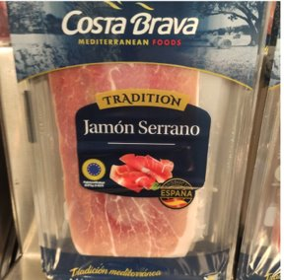
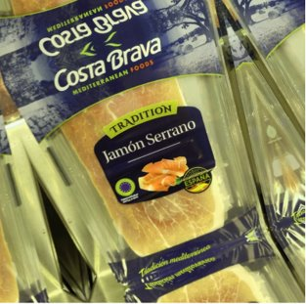
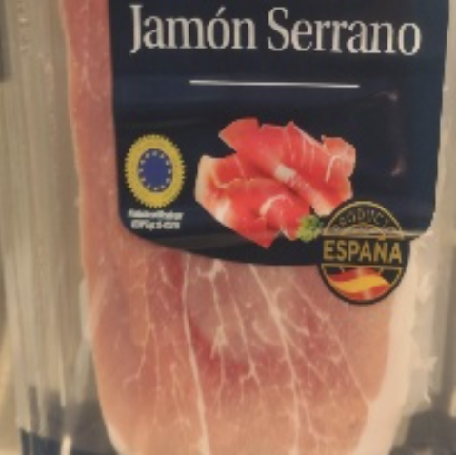
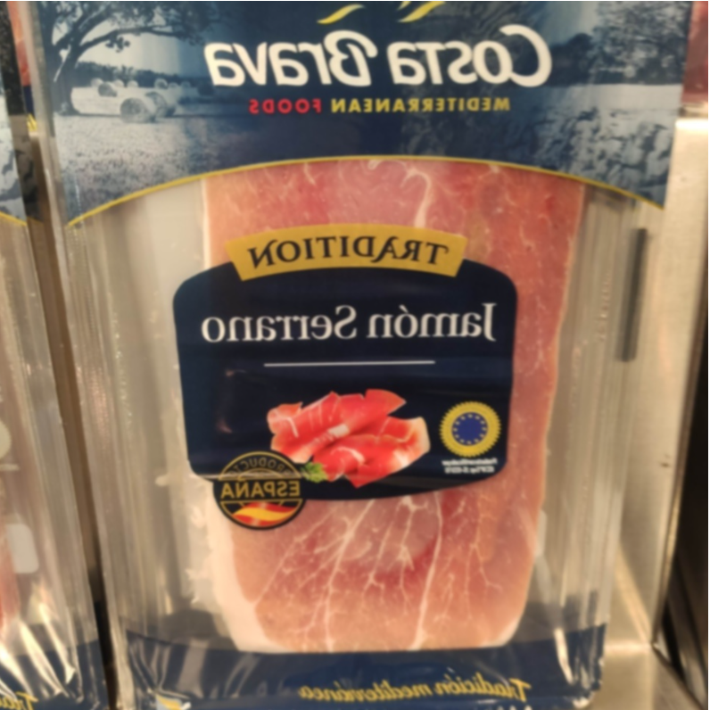
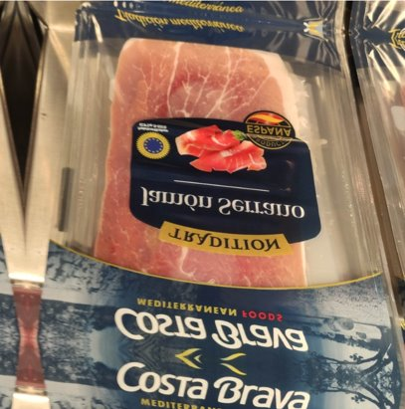
Data Augmentation Operations
Original
Safe Rotate
&
Color Jitter
Contrast
&
Cropping
Horizontal Flip
&
Blurring
Vertical
Flip
&
Elastic Transform
Notes:
- Train test split → then augment train data with our pipeline

Slide 9
Our Data Processing Pipeline
Data Collection
Labeling
LabelImg
Guidelines
Data Resizing
Data Split
Training Data​
Data Augmentation
Test Data: 60 Images
Training Data: 1400 Images

Slide 10

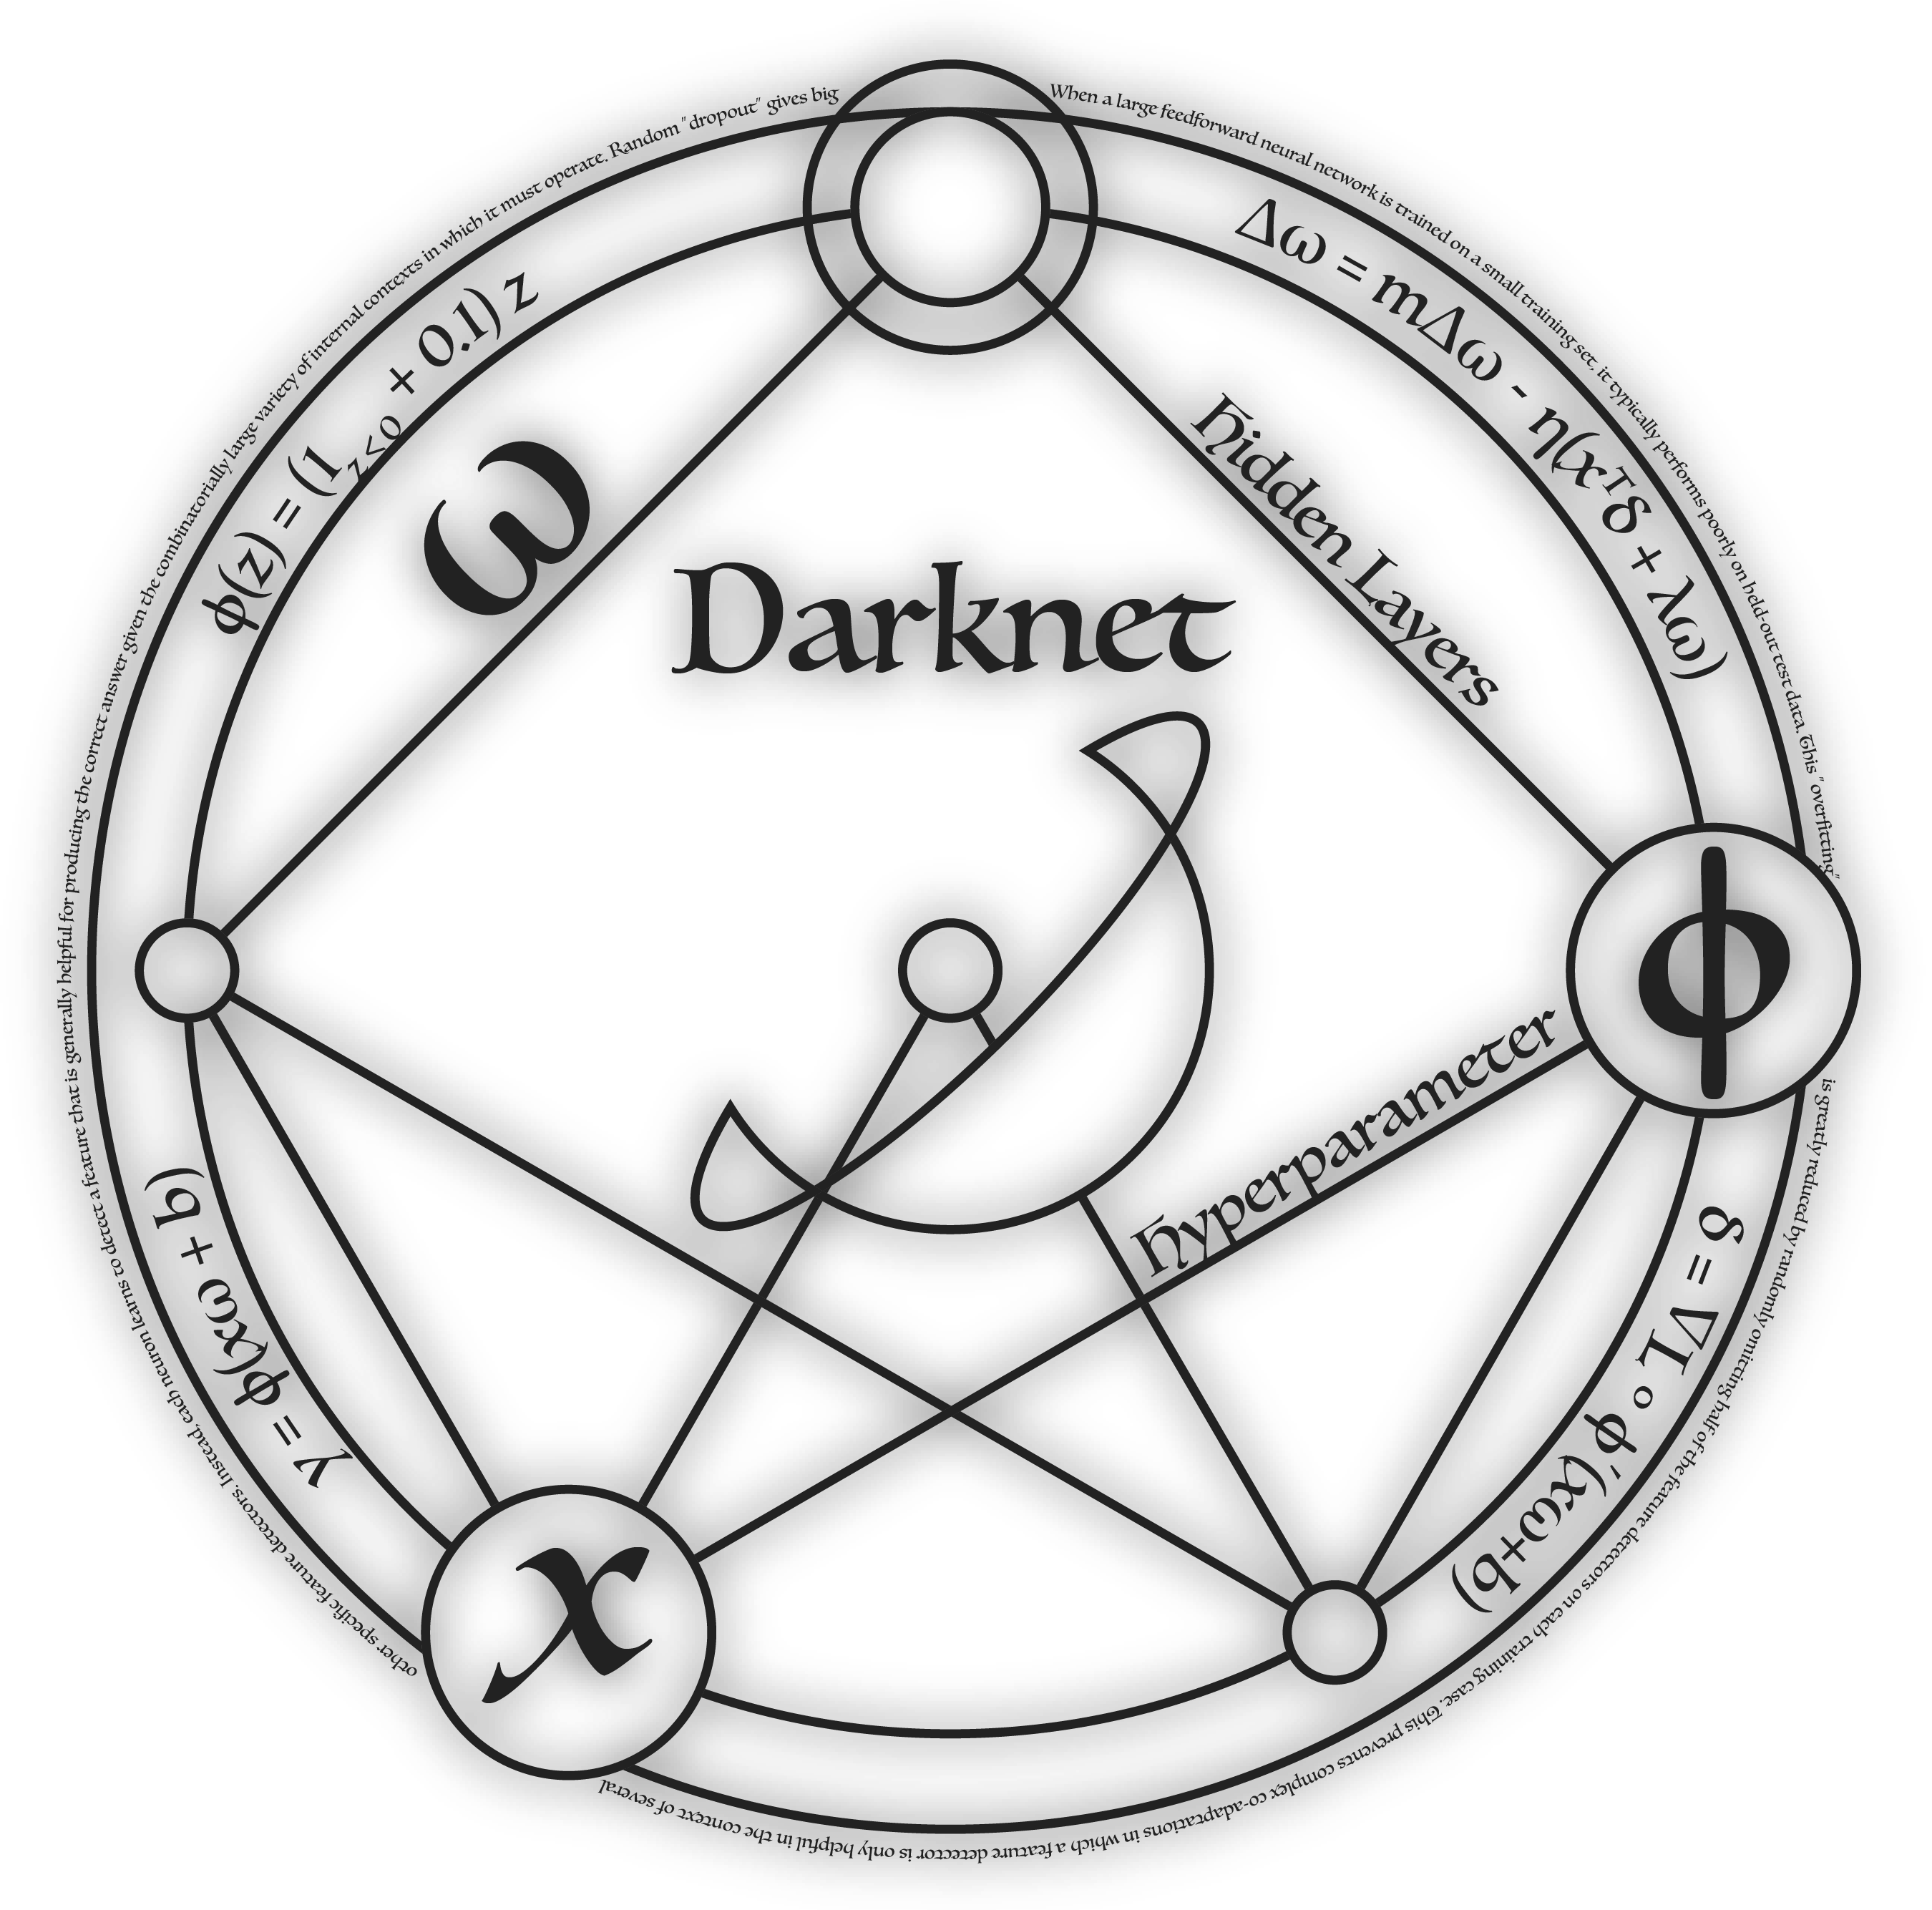

Choosing The Right Model For The Task
Pretrained & SOTA object detection model
Small model for fast inference on Jetson Nano (Accuracy-Speed Tradeoff)
Simple training and inference API using „Darknet“ Framework
Tiny YOLO v4
+ Darknet
Notes:
As almost all of us did, We selected a pretrained and state-of-the-art object detection model configuration to leverage existing knowledge.
To ensure fast inference on the Jetson Nano, balancing accuracy and speed for optimal performance, instead of the most powerful We chose Tiny Yolo v4 model to our usecase.
Especially, We're using the Darknet framework, which provides a simple API for both training and inference, streamlining our development process.

Slide 11

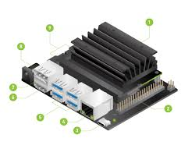
Final Training & Using Darknet
Deploy and Use on Jetson Nano
Train on separate GPU for acceleration
1771 train images
To run Darknet, it’s necessary to recompile OpenCV in order to support CUDA and GStreamer
NVIDIA RTX 4090 GPU
Notes:
In termes of Training and Deploy process, after trying and failing with different approaches, we developed such a workflow.
We train our model on a separate GPU 4090, to accelerate the training process with more than one thousand training images.
After training, we deploy and use the model on a Jetson Nano, here is worth noticing, To run Darknet efficiently on the Jetson Nano, we needed to recompile OpenCV with CUDA and GStreamer support, ensuring optimal performance.

Slide 12


Good Quality of Model Predictions
214 Bounding Boxes
Correct: 188
Missed: 26
no label
Incorrect: 15

Slide 13
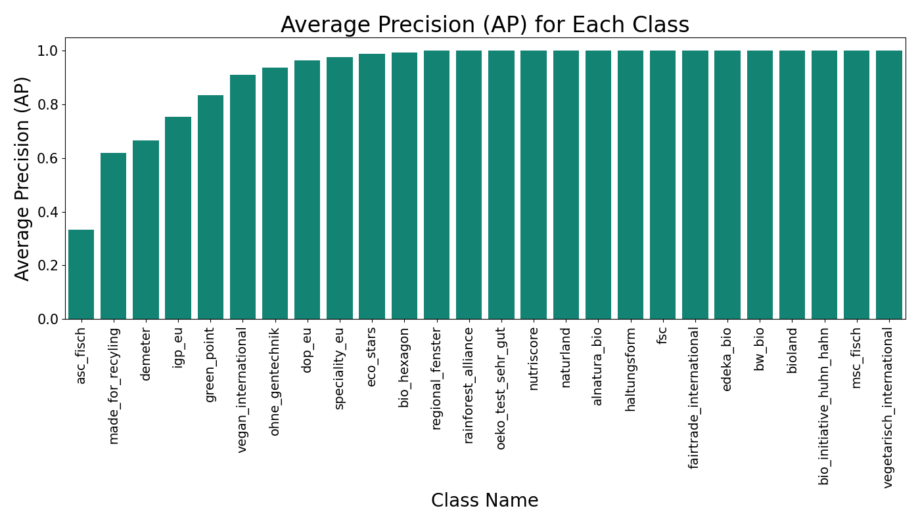
Our Model Achieves A High Average Precision
Notes:
Average Precision is a score that considers precision as well as recall
Mean Average Precision Score (over all classes): 92%

Slide 14
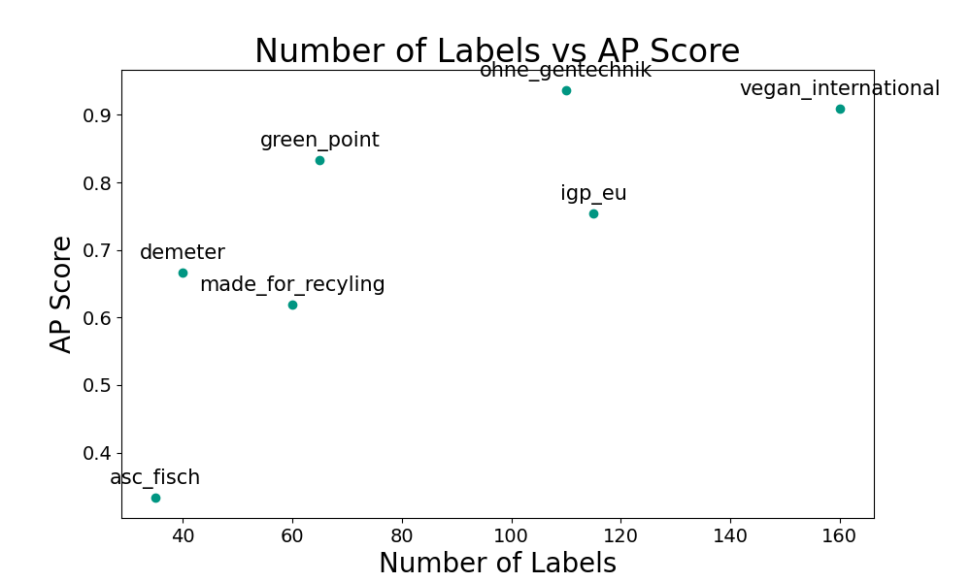
Relationship: Number of Labels & AP Score

Slide 15
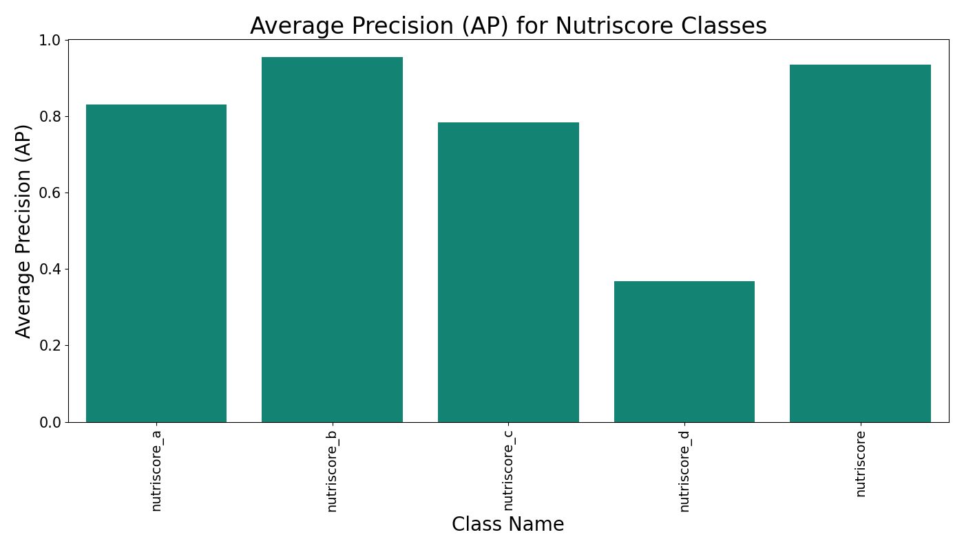
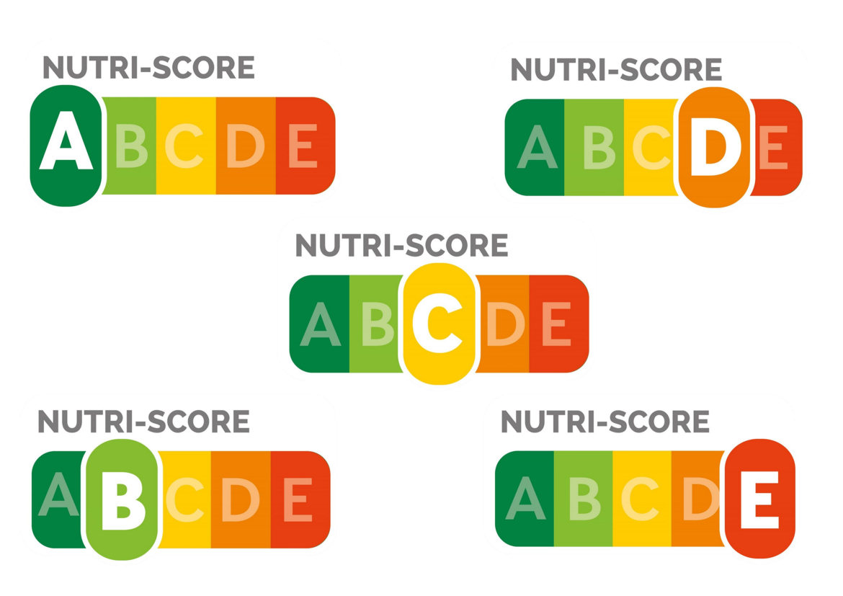
Improving Poor Performing Classes

Slide 16
Improving Poor Performing Classes
Better
Score
?

Slide 17
Improving Poor Performing Classes

Slide 18
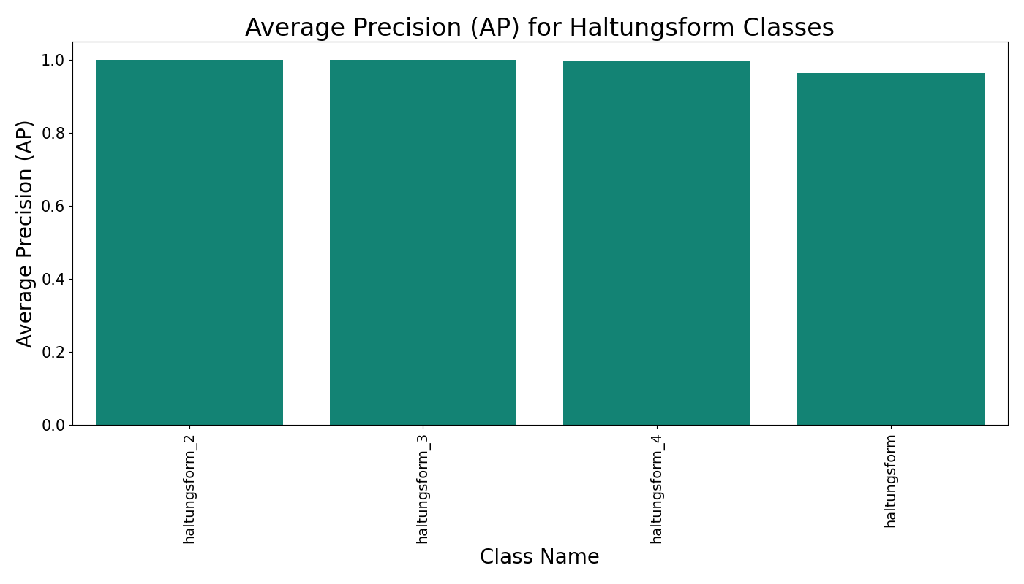
No Benefit For Already Well Performing Classes
Notes:
AP Unmerged vs Merged – Haltungsform (→ No benefit for already well performing classes)

Slide 19




Putting It All Together
Frontend
Provide detected labels
Trigger inference
Jetson Nano
Run inference
Take picture using CSI camera
Notes:
First image process
Foto taken and send to darknet
Inference run on the image
Now: improved to an improved video version
→ Here the video stream from the camera is directly taken as a model input …

Slide 20
Let‘s Run Our Model!
Notes:
→ Yigit

Slide 21




Thank You For Your Attention ☺
Business Case
Data Preparation
CV Application to detect labels on supermarket items and provide information to users
Collect images from supermarket
Augment images to increase model performance → avoid data leakage
Training & Inference
Frontend Integration
Train Darknet on GPU, run inference on Jetson Nano
Flask webapp allows users to run inference on Jetson Nano using video/ image stream from CSI camera

Slide 22
Backup Slides

Slide 23
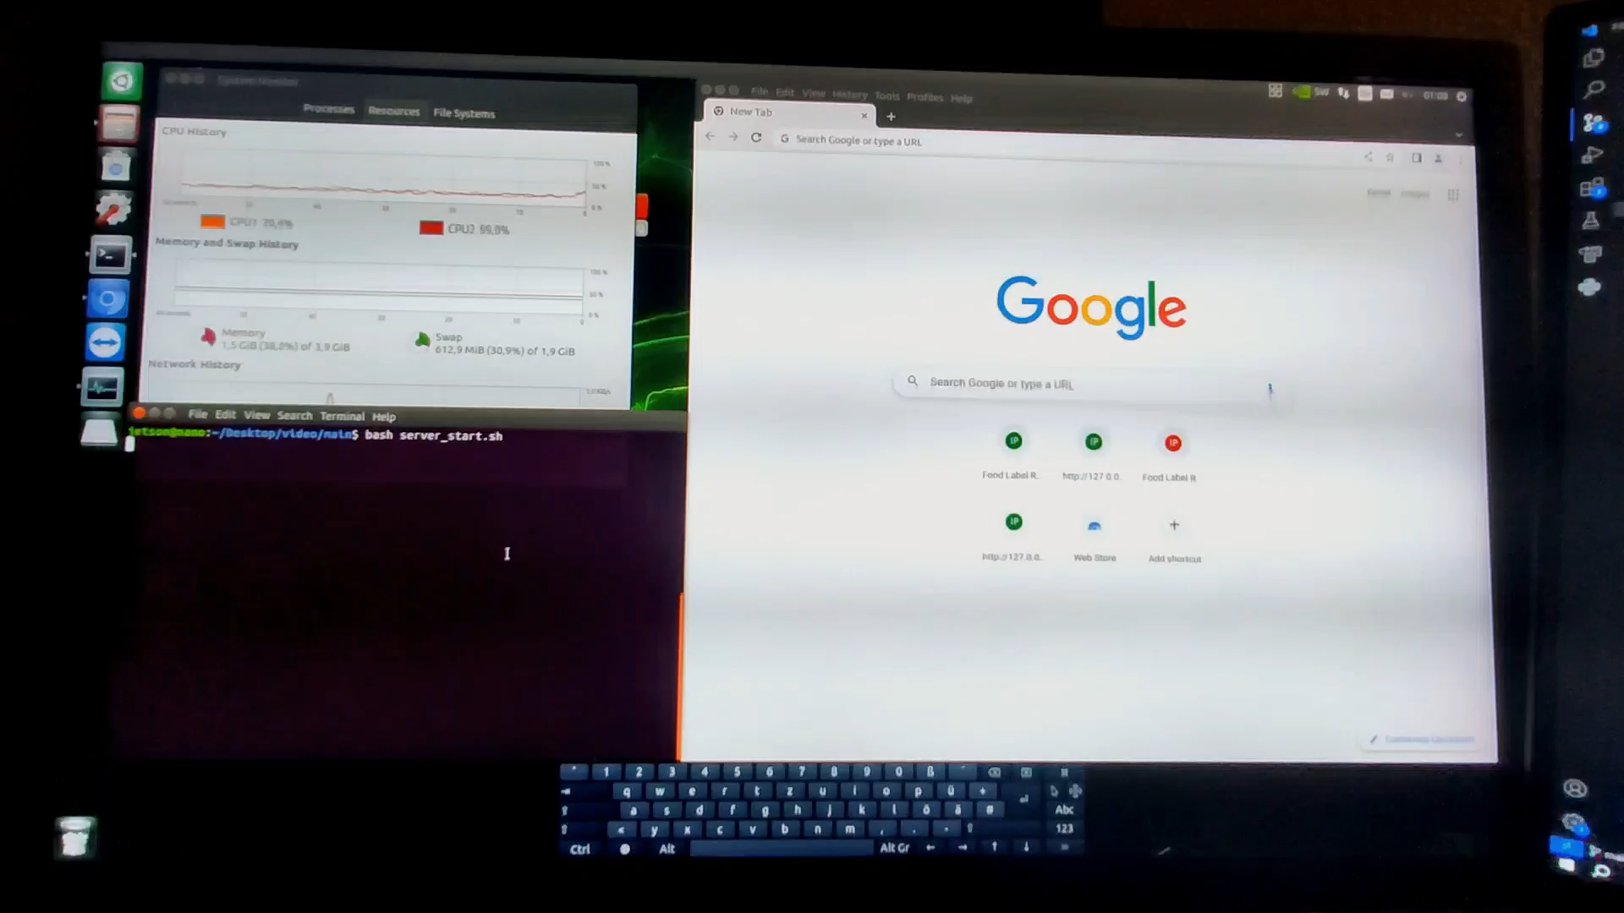

Slide 24
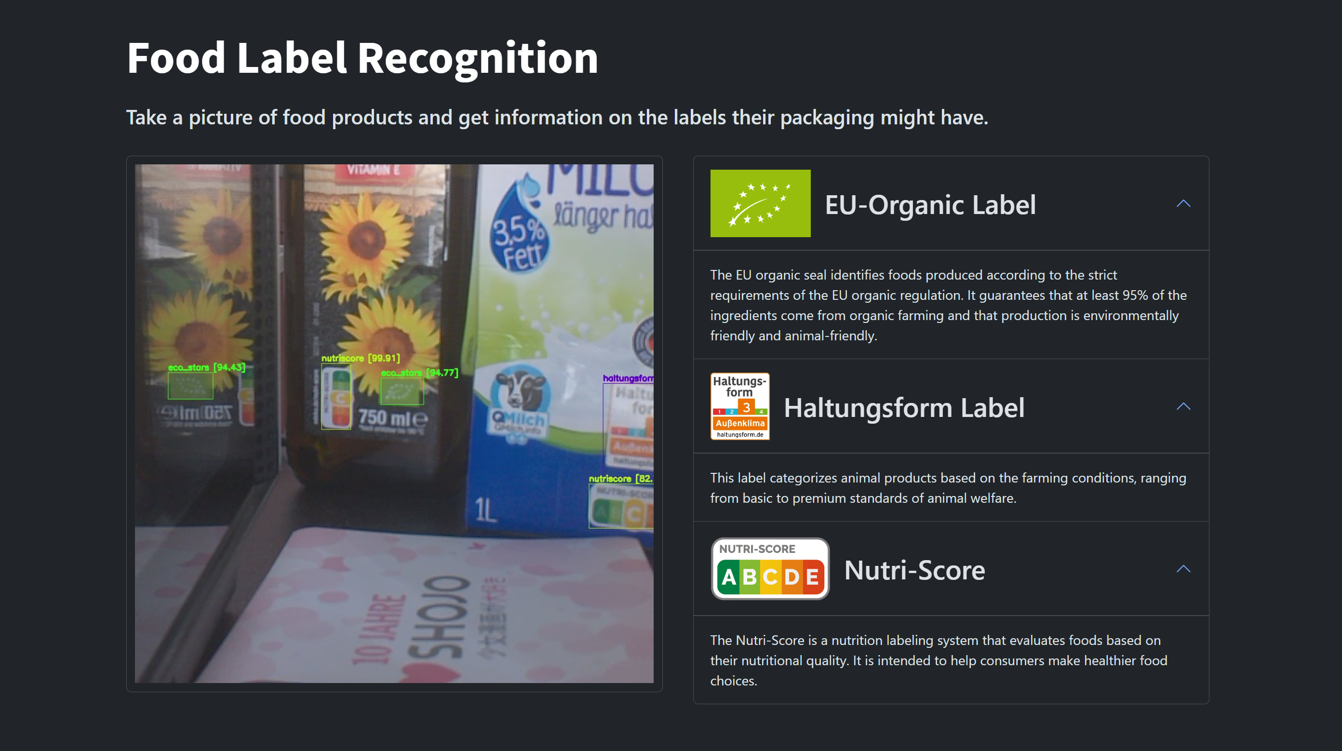
Web Frontend – Video Stream & Label Information

Slide 25
Results in Detail
Mean Average Precision Score: 92%
Intersection over Union: 74.06 %
Test BBoxes: 214
TP: 188
FP: 26
FN: 15

Slide 26
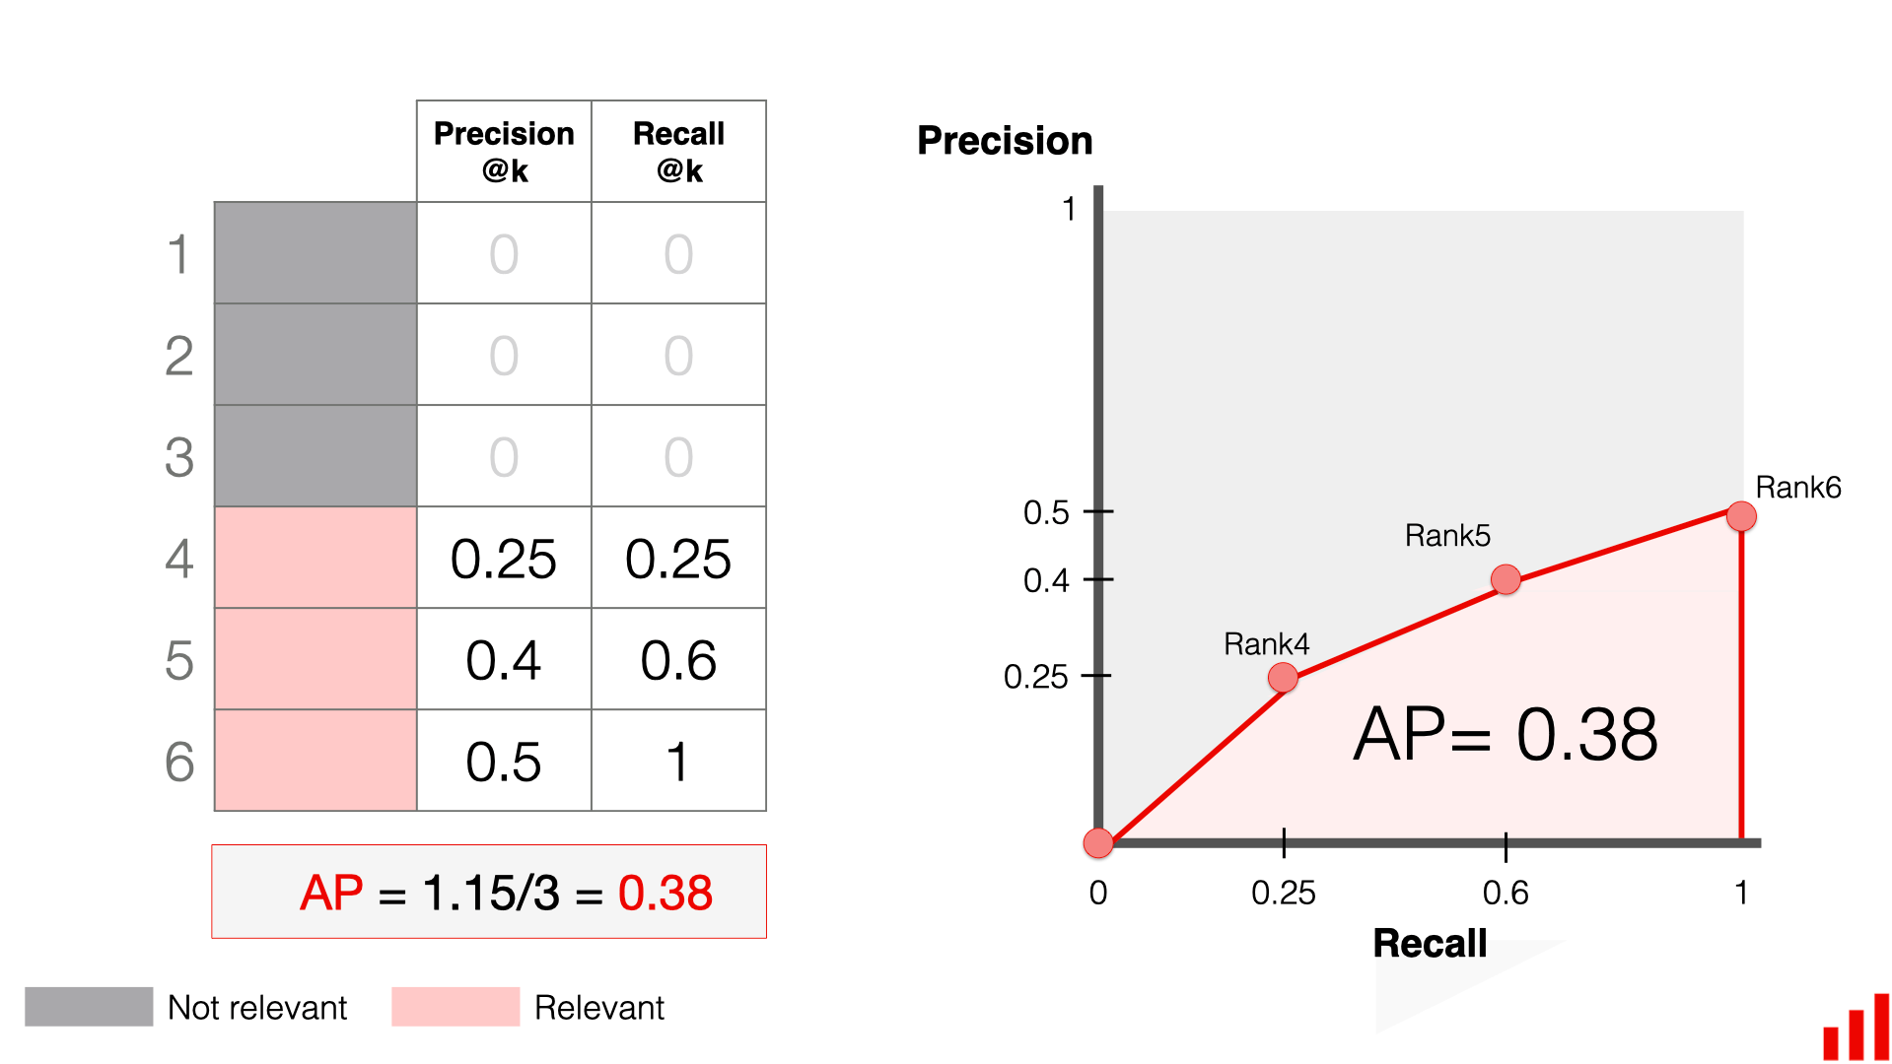
Our Model Achieves A High Average Precision
AP per class:
Calculate Precision and Recall based on IoU for different confidence thresholds
Plot Precision-Recall Curve:
AP=Area under Curve
AP considers the precision-recall trade-off
Notes:
Average Precision is a score that considers precision as well as recall

Slide 27
Program Flow – 1st Version with Streamlit
Save picture in folder
Save classifi-cation result in folder
Camera Program
Model Script
Frontend GUI
Scan folder and run on image
Scan folders and display results
Runs in background, take picture on key press
Python script executing terminal commands to run model
Browser window powered by streamlit python script
Input: Image file
Text file
Output: Image file
Input: Image file
Output: Text file

Slide 28
Program Flow – 2nd Version: Flask Images
Save picture in folder
Transmit data directly in Python
Camera Program
Model Script
Frontend GUI
[No actual files saved]
Scan folder and run on image
Runs in background, take picture on key press
Darknet model accessed via Python wrapper
Browser window powered by Flask and JS
Input: Image file
Python strings
Output: Image file
Input: Image file
Output: Python strings

Slide 29
Program Flow – 3rd Version: Flask Video
Transmit data directly in python
Transmit data directly in Python
Camera Program
Model Script
Frontend GUI
[No actual files saved]
[No actual files saved]
Runs in background, records video stream
Darknet model accessed via Python wrapper
Browser window powered by Flask and JS
Input: Python image
Python strings
Output: Python image
Input: Python image
Output: Python image

Slide 30
References
https://www.freepik.com/free-vector/hand-drawn-woman-supermarket_4104602.htm#fromView=search&page=2&position=0&uuid=215175ba-a29a-4a77-aeb5-fb61ce7917c2
https://www.evidentlyai.com/ranking-metrics/mean-average-precision-map
https://www.verbraucherzentrale.de/wissen/lebensmittel/kennzeichnung-und-inhaltsstoffe/nutriscore-was-bedeutet-die-kennzeichnung-76209

Slide 31




Team Organization – Tools
Discord server – chat & weekly meetings
Miro board – brainstorming & planning
GitLab repo – code & wiki
Shared cloud – dataset (images)

Slide 32
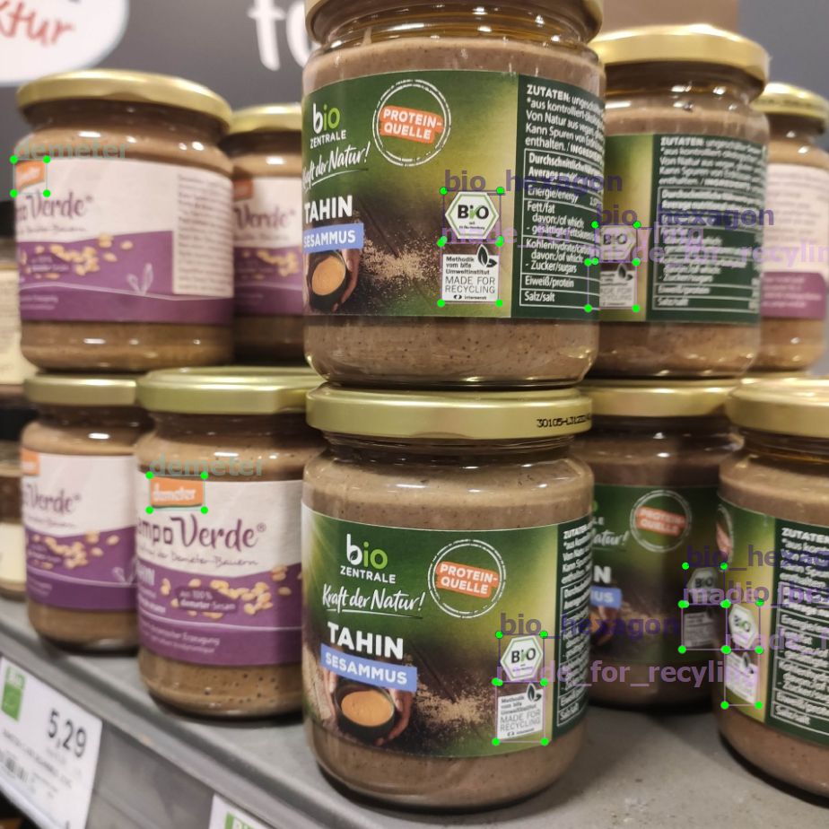

Model Overview – ML Task
Object Detection
Multiple objects per image
Multiple bounding boxes

